Slide 1


Slide 2

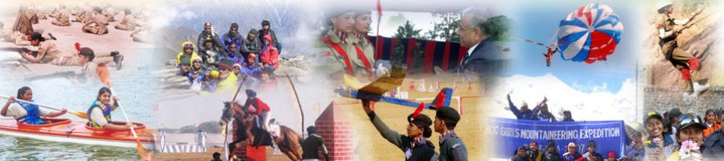
OFFICERS TRAINING ACADEMY
ADVENTURE ACTIVITIES IN NCC

Slide 3
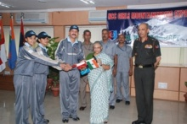
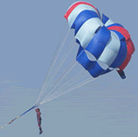
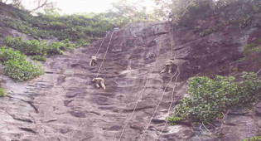
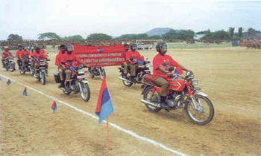
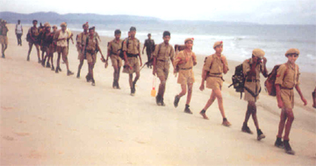
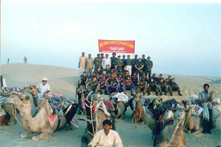
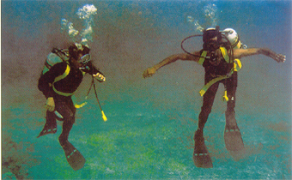
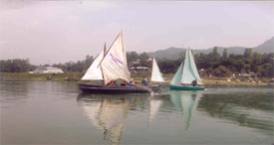
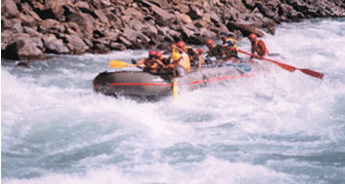

Slide 4


ADVENTURE TRAINING
ADVENTURE ACTIVITIES HAVE BEEN INCORPORATED IN NCC TRAINING WITH AN AIM OF INCULCATING & STRENGTHENING LEADERSHIP TRAITS AMONGST CADETS. THESE ACTIVITIES IN NCC CAN BE BROADLY DIVIDED INTO FOLLOWING:-
LAND BASED.
WATER BASED.
AIR BASED.

Slide 5
MOUNTAINEERING
AIM OF MOUNTAINEERING EXPEDITIONS IN NCC, IS TO STRENGTHEN CHARACTER, INSTILL VALUES OF COURAGE, COMRADESHIP, DISCIPLINE, LEADERSHIP, SECULAR OUTLOOK, DETERMINATION AND PERSEVERANCE IN CADETS. THEY ALSO GIVE A CHANCE TO CADETS TO EXPLORE FLORA AND FAUNA AND MEET FRIENDLY PEOPLE OF THE HILL REGIONS.

Slide 6
MOUNTAINEERING
THE PEAKS ARE SELECTED IN CONJUNCTION WITH IMF. NCC PROVIDES THE EQUIPMENT WHICH IS OF THE BEST QUALITY AVAILABLE IN MARKET. TEAM IS LED BY EXPERIENCED MOUNTAINEERS FROM THE SERVICES. THIS IS VERY POPULAR ADVENTURE ACTIVITY, BOTH WITH BOY AND GIRL CADETS.

Slide 7

THREE PREMIER MOUNTAINEERING INSTITUTES WHERE CADETS UNDERGO MOUNTAINEERING COURSES:
    NEHRU INSTITUTE OF MOUNTAINEERING, UTTARKASHI.
    HIMALAYAN MOUNTAINEERING INSTITUTE, DARJEELING.
    MOUNTAINEERING AND ALLIED SPORTS, MANALI.
VACANCIES ON COURSES ARE ALLOTTED EVERY YEAR TO VARIOUS DIRECTORATES BASED ON THEIR DEMAND/ STRENGTH.

Slide 8
VACANCIES AVAILABLE
BASIC MOUNTAINEERING
  SD - 130.
  SW - 30.
  JD - 40.
  JW - 40.
ADVANCE
  SD - 27.
  SW - 10.

Slide 9
ROCK CLIMBING

Slide 10
SAILING
SAILING EXPEDITION IS AN INTERESTING FEATURE OF THE NAVAL TRAINING. DURING SAILING EXPEDITIONS, THE CADETS GET PRACTICAL TRAINING IN BOAT PULLING AND SAILING. COASTAL STATES CONDUCT SAILING EXPEDITIONS AT SEA, AND IN THE MAJOR RIVERS BY THE STATES. THEY LEARN TO SURVIVE AT SEA AND OVERCOME THE VAGARIES OF THE WEATHER.

Slide 11
PARASAILING
546 PARA SAILS ARE HELD WITH VARIOUS DIRECTORATES. REGULAR LAUNCHES ARE CARRIED OUT BY THE DTES. 20 SD/SW CADETS TAKE PART IN PM'S RALLY EVERY YEAR.

Slide 12
TREKING
A TOTAL OF TEN ALL INDIA TREKS ARE CONDUCTED EVERY YEAR I.E. THREE FOR GIRLS AND SEVEN FOR BOYS AND A TOTAL OF 10,000 CADETS TAKE PART IN IT.

Slide 13
CAMEL SAFARI
CAMEL SAFARI IS UNDERTAKEN IN RAJASTHAN USUALLY IN THE MONTH OF OCT. FOREIGN CADETS ARE ALSO INVITED TO JOIN IN THE SAFARI.

Slide 14
MOTOR CYCLE EXPEDITION
THESE EXPEDITIONS ARE CONDUCTED AT DIRECTORATE LEVEL.

Slide 15
WHITE WATER RAFTING
A WHITE WATER RAFTING NODE IS BEING ESTABLISHED AT HARIDWAR. RAFTING WILL BE CARRIED OUT FOR CADETS FROM ALL OVER THE COUNTRY. SUBSEQUENTLY NODES WILL BE ESTABLISHED IN OTHER STATES AS WELL, DEPENDING ON FEASIBILITY OF RAFTING IN THOSE AREAS.

Slide 16

SCUBA DIVING
DIVING HAS GAINED POPULARITY AMONG NCC CADETS IN RECENT YEARS, THOUGH ITS INCEPTION TOOK PLACE IN 1982. THESE COURSES ARE NOW BEING CONDUCTED AT KOCHI, VIZAG, AND MUMBAI WITH COMPLETE ASSISTANCE FROM THE NAVAL DIVING TEAMS.

Slide 17
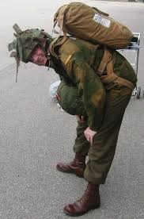
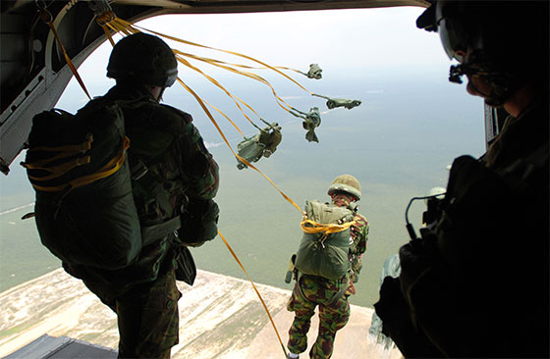
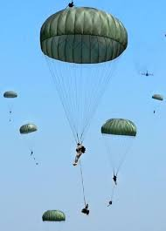
PARA JUMPING
COURSE IS CONDUCTED AT PARA TRAINING CENTRE, AGRA FOR SELECTED NCC CDTS. VACANCIES ARE ALLOTTED BASED ON DEMAND BY UNITS THROUGH NCC DIRECTORATES.

Slide 18
CONCLUSION

Slide 19
CONCLUSION
ONE OF THE MAIN METHODS OF CHANNELISING THE ENERGY IS TO KEEP THE YOUTH ENGAGED IN SOME CREATIVE ACTIVITY. ADVENTURE TRG IS ONE SUCH ACTIVITY WHERE YOUTH OF TODAY AND NCC CADETS MUST BE GIVEN MAXIMUM FACILITIES TO DEVELOP LEADERSHIP QUALITIES, ABILITY TO TAKE RISKS, SELF CONFIDENCE AND ESPIRIT-DE- CORPS.

